Slide 1
Better Life Company
Travel More, Travel Better and Travel for less

Slide 2
Decade in business - 2013
March Starts our 2nd decade in business
Debt free
Travel inventory Pre-paid 2023
Commissions
Millions paid in commissions
Global
Business
Product
Opportunity
Temecula, California

Slide 3
Market Place / timing / advantage
Travel Industry
Estimated at 9 Trillion dollars in 2023
Business of Dreams
Easy to explain and fun to do
Side Hustle / Home based business

Slide 4
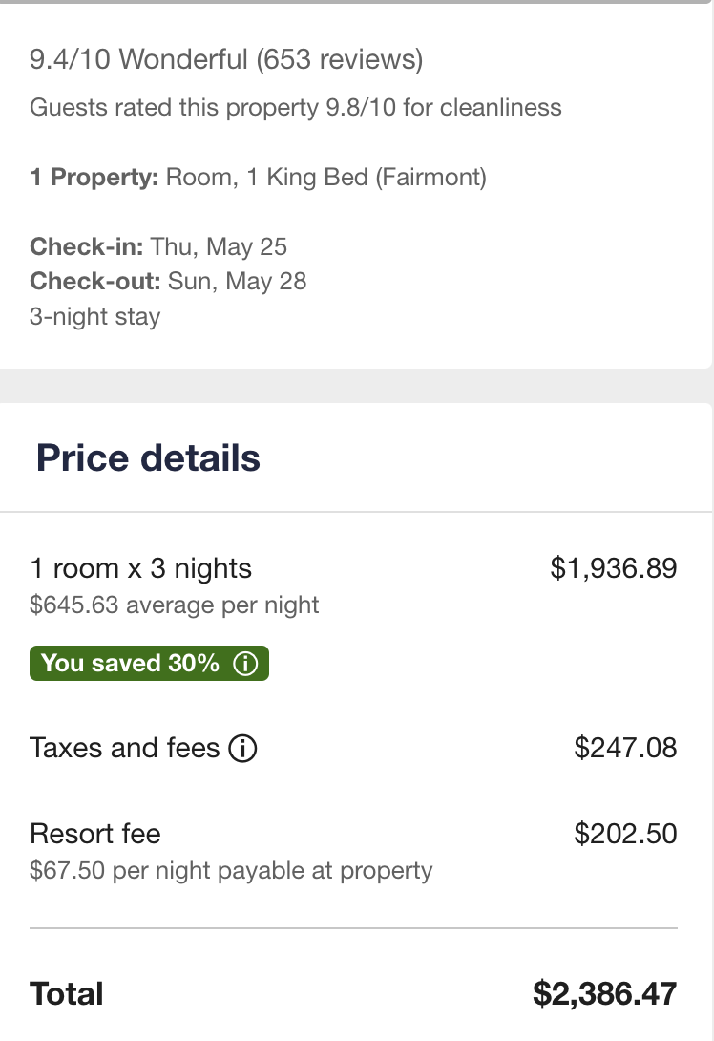
Better than Travel Agents Rates - 2,000,000 Hotels
Travorium Travel Site vs. Retail Rates
Save as much as 50%
$1,256.57 Savings

Slide 5
World Tours 100 + Over Next 18 months
Venice, Italy
Dubai
Montego Bay, Jamaica
Retail Rate: $1,110.00
Retail Rate: $799.00
Retail Rate: $1716.00
Travorium Rate: $360.00
Travorium Rate: $99.00
Travorium Rate: $612.00
5 Days
Breakfast Included
Glass Factory Tour
Complimentary Water Shuttle
5 Star Hotel
6 Days
Breakfast Daily
5 Star Resort
5 Days
All-Inclusive

Slide 6
Getaways - 2,000 Resorts - 300,000 + weeks
Canary Islands
Cabo San Lucas
Orlando, Florida
Retail Rate: $899.00
Retail Rate: $1,299.00
Retail Rate: $1149.00
Travorium Rate: $7.00
Travorium Rate: $149.00
Travorium Rate: $142.00
Plus Tax
8 Days / 7 nights
1 Bedroom Suite
Plus Tax
8 Days / 7 Nights
2 Bedroom Suite
Plus Tax
8 Days / 7 Nights
Studio

Slide 7
Silver membership - $69.95
Better Than Travel Agent Rates
$52.50 MONTHLY
Titanium Membership -$149.95
Better Than Travel Agent Rates
World Tours - up t0 50% OFF retail
Getaways - up to 50% OFF retail
Incentive trip once a year
$75.00 monthly
Platinum membership -$269.95
Better Than Travel Agent Rates
World Tours - up to 80% off retail
Getaways - up to 80% off retail
Incentive trip once a year
$135.00 monthly

Slide 8
Partnership - $79.95 Annually
Website
Back office
Marketing videos
Training
Done for you product
Tax advantages

Slide 9
3 to Profit - Ability
Sales Team 1
Sales Team 2
2 x 2 Sales Team
188 Platinum Sales Each Sales Team = $80k - $100k + Annually
25 Platinum Sales Each Sales Team = $1,500 - $2,000 monthly
8 Platinum Sales Each Sales Team = $400 - $700 Monthly
63 Platinum Sales Each Sales Team = $30,000+ Annually
Earn up to $3,200 Daily Residual Pay
This not an income claim - Income is solely earned on the sale of membership

Slide 10
Ambassador lifestyle
Global Bonus pools / Louis Vuitton Experience / Vacations / awards

Slide 11
Better Life Company
“A Business opportunity showing people how to make money by showing others how to save money on travel”

